Slide 1
Swiggy Restaurant Recommendation System using Streamlit
Presented by
Shanchai Kumar S

Slide 2
Table of contents
_01
_02
_03
_04
_05
_06
Problem Statement
Data Preprocessing
Data Understanding and Cleaing
Streamlit App
Live Demo
Recommendation Methodology

Slide 3
_01
Problem Statement

Slide 4
Problem statement
The objective is to build a recommendation system based on restaurant data provided in a CSV file.
The system should recommend restaurants to users based on input features such as city, rating, cost, and cuisine preferences.
The application will utilize clustering or similarity measures to generate recommendations and display results in an easy-to-use Streamlit interface.

Slide 5
_02
Data Understanding and Cleaning

Slide 6
Data Understanding & cleaning
The dataset is a CSV file containing restaurant information with categorical (name, city, cuisine) and numerical (rating, rating_count, cost) features.
Data cleaning Steps:
Duplicate Removal: Identify and drop duplicate rows.
Handling Missing Values: Impute or remove rows with missing values.
Save Cleaned Data: Export the cleaned dataset as cleaned_data.csv

Slide 7
_03
Data Preprocessing

Slide 8
Data Preprocessing
One-Hot Encoding: Convert categorical columns (name, city, cuisine) into numerical format.
Save Encoder: Store the trained encoder as encoder.pkl using Pickle to ensure consistent future transformations.
Ensure Numerical Features: After encoding, all features should be in numeric form.
Create Encoded Dataset: Save the transformed dataset as encoded_data.csv.
Maintain Index Matching: Ensure the indices of cleaned_data.csv and encoded_data.csv remain aligned for consistency.

Slide 9
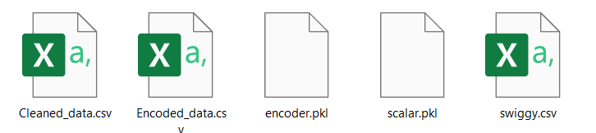
After these steps:
We have two csv and two encoder files which is used for Streamlit application to find the similar restaurants using cosine similarity

Slide 10
_04
Streamlit App

Slide 11
Streamlit App
Loading Data:
cleaned_data.csv for human-readable restaurant details.
encoded_data.csv for numerical feature representation.
Loading Encoders:
One encoder for categorical feature transformation (e.g., encoder.pkl).
Another encoder, possibly for additional preprocessing or mapping.
Finding Similar Restaurants:
Use cosine similarity on encoded_data.csv to compute restaurant similarities.
Retrieve and display results using cleaned_data.csv for interpretation.

Slide 12
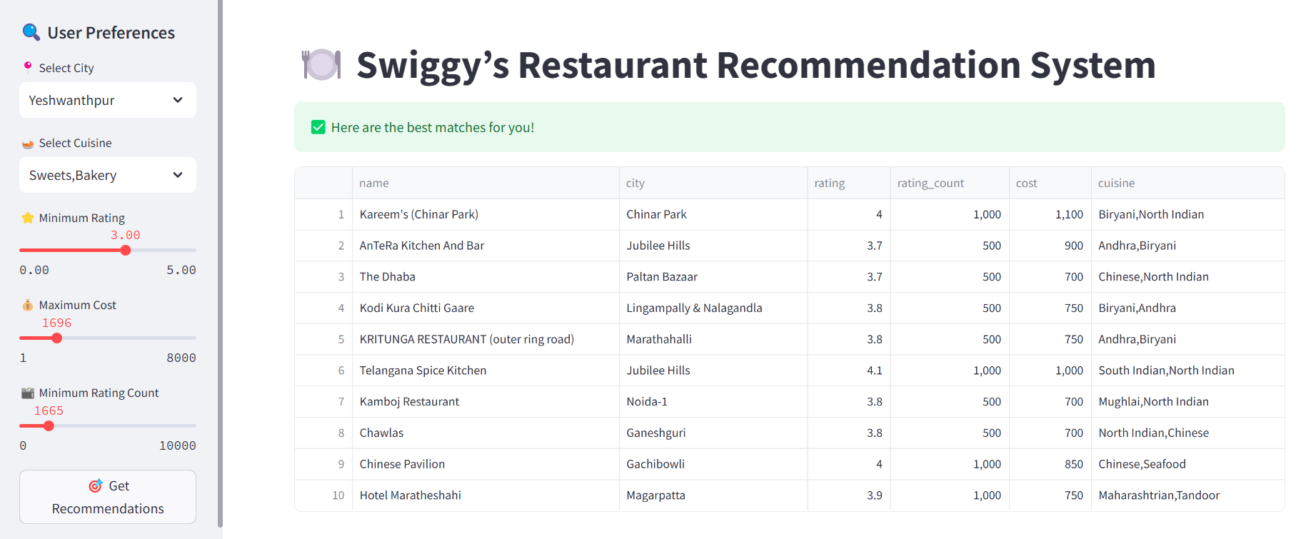
Sample View

Slide 13
Live Demo

